Slide 1
Browser Tab Titles
Audit and design recommendations by Giorgi Plys-Garzotto

Slide 2
Overview
The browser tab titles for Meta’s ads and business products cause confusion for users who are reliant on screen readers, who have multiple tabs open, and who use Meta products in languages other than English.
As part of the Seamless Foundations initiative, I have undertaken an audit of the current tab titles and are conducting research as possible about more effective taxonomies Meta could implement in the future.

Slide 3
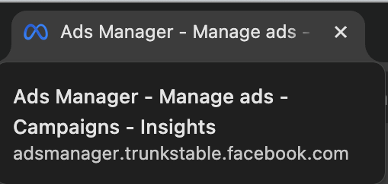
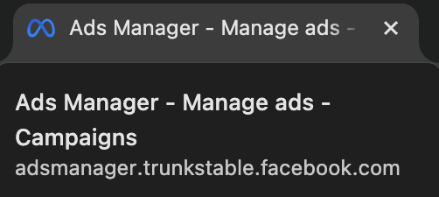
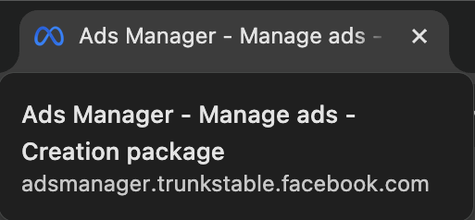
Current browser tab titles
Lists the largest groupings first
Some titles are cut off at the end
The mid-level categories are confusingly labeled
Too long overall

Slide 4
Problems to solve
Users with screen readers have a poor experience of our tab titles because they’re longer than best practices suggest, and present important info last. This is especially urgent given the EAA coming into effect in 2025.
The tab title system is inconsistent and confusing, with many pages simply being titled “Meta Business Suite.”
1
3
2
It’s difficult for users to keep many tabs open at once, because the mouse-hover view of a tab title often cuts off the most important part–namely, the actual title of the page.
4
Users navigating ads and business products in other languages often have even more problems with usability due to translations that are longer than the original and less convenient cut-offs of titles.

Slide 5
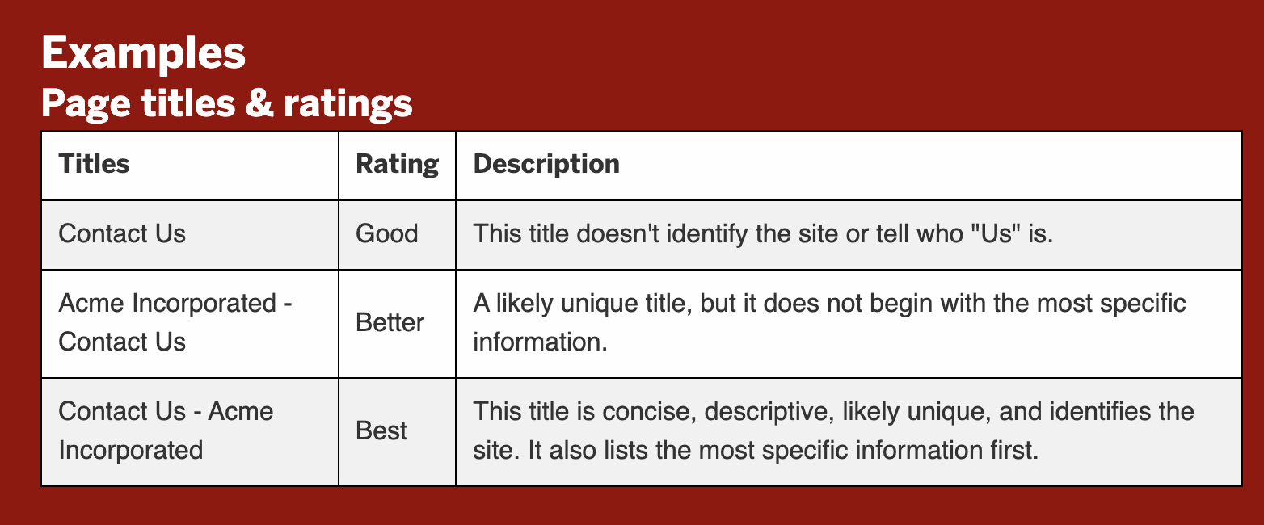
Research phase
“In cases where the page is a document or a web application, the name of the document or web application would be sufficient to describe the purpose of the page.” - w3.org

Slide 6
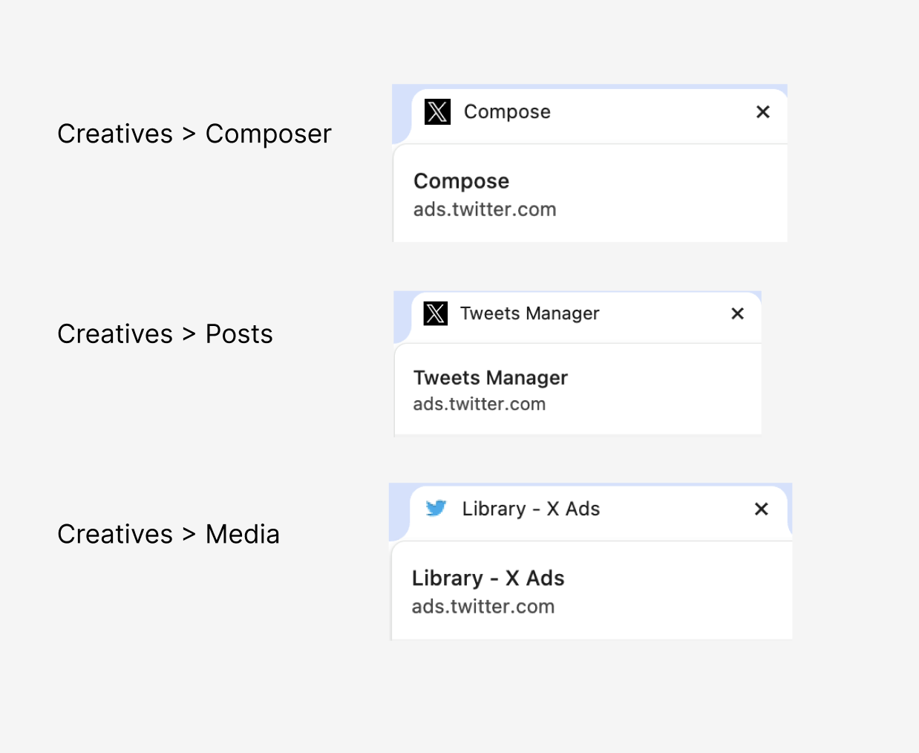
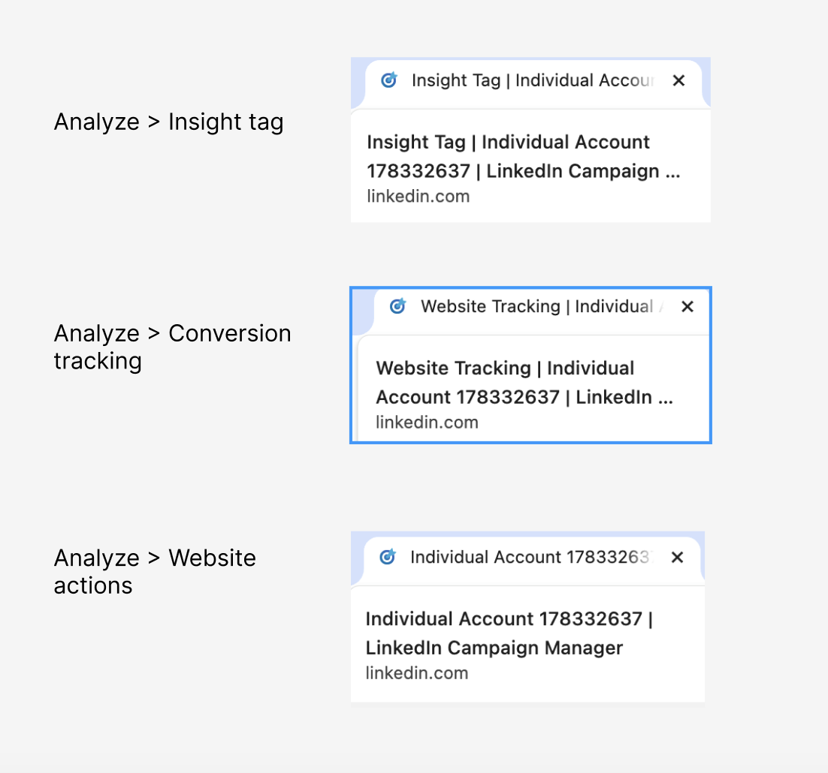
Competitive Analysis

Slide 7
Proposed solution, v1
Element Order: Tool - Task - Group - System
(Two elements maximum)
Examples: Campaign - Edit
Reporting - Ads Manager
Overview - Commerce Manager

Slide 8
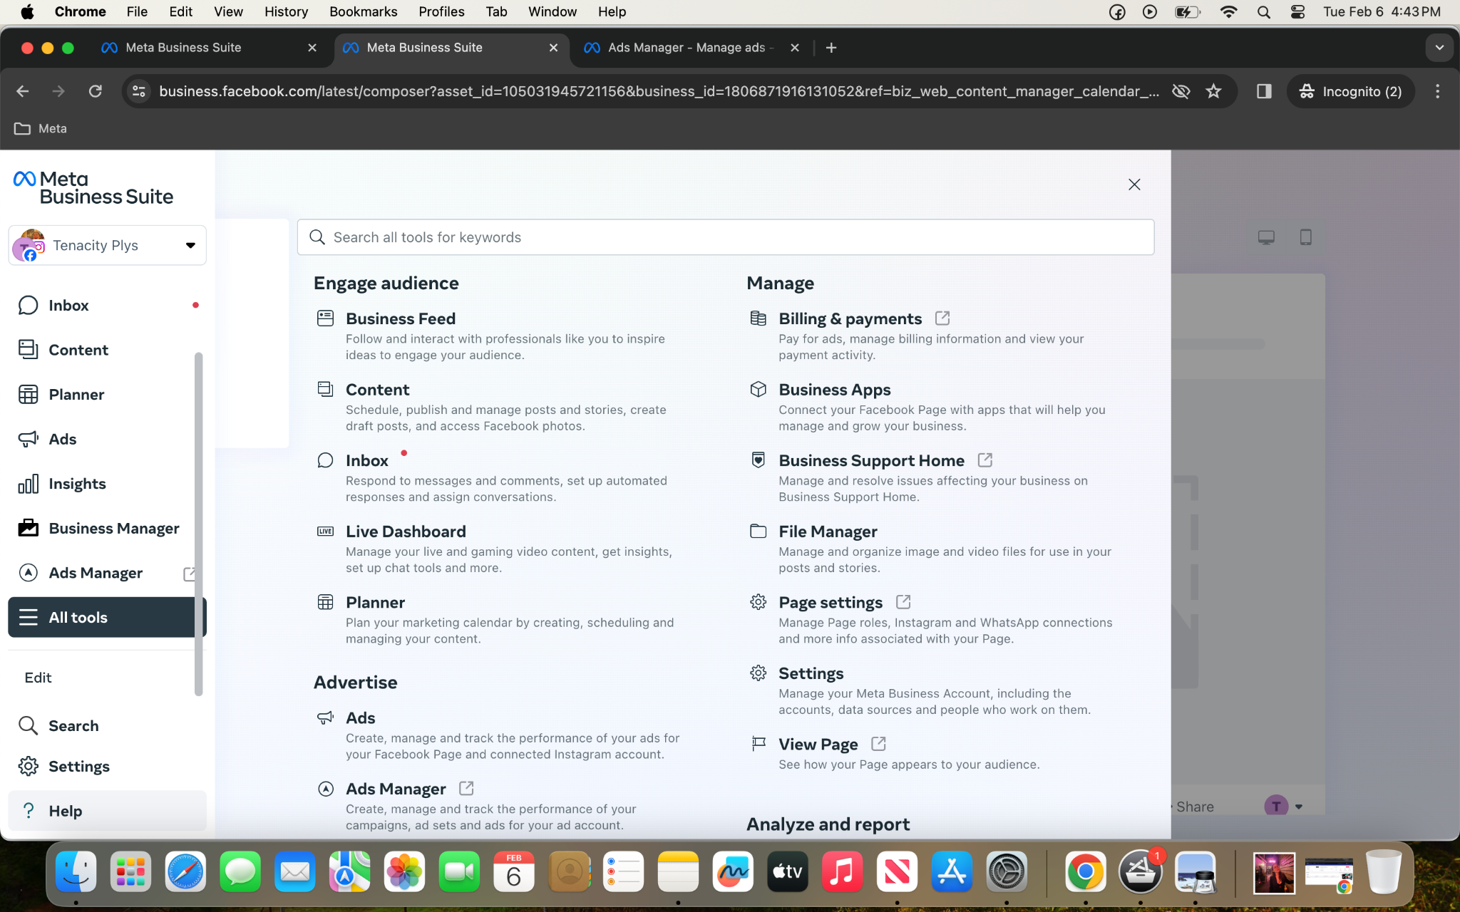
My v1 still had some flaws:
Still confusing at times
I noticed some grouping names could be combined
Some names could be shortened or edited
All tools menu groups (pictured) were unhelpful

Slide 9
Proposed solution, v2
Tool - Task - Group System is the hierarchy
Two terms per title: “Tool - Task” or “Tool Group”
If two terms can be combined into a clause, e.g. “edit campaign” rather than campaign - edit,” do that to consolidate title terms.
Don’t include categories from the All Tools menu unless they are meaningful to the title. For instance “Engage” can be left out, but “Create” can be combined with “Create Post” to make a clause.
Sentence case except for proper nouns.

Slide 10
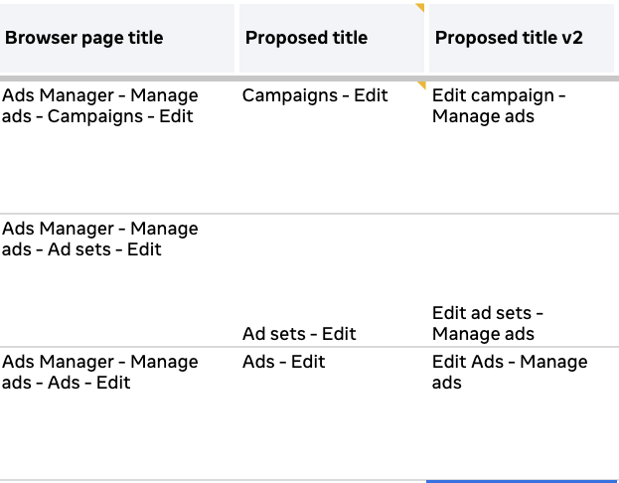

Slide 11
Improvements Upon Original
Accessibility is improved because the shorter and clearer titles are in line with best practices for screen readers under the EAA.
Users hovering over browser tabs will be able to see what the page is immediately, rather than seeing the same title for most pages (namely, “Meta Business Suite.”
The system is more consistent than the original, giving users the sense of using a unified set of ads and business products.
Shorter titles make localization easier, and we plan to work with localization specialists to make added improvements.

Slide 12
Thank you!

